Slide 1
Modeshift TravelWise Week
In conjunction with

Slide 2
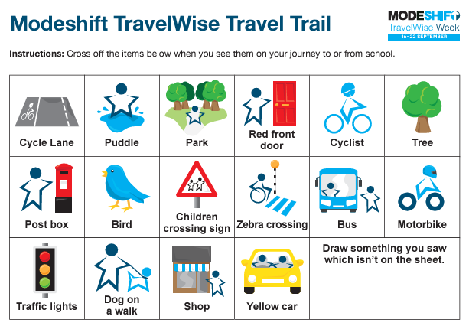
Join in
Walk, Scoot or Ride to school and collect a raffle ticket to be entered into the prize draw at the end of the week.
Monday 16th
Take part in the Travel Wise Trail on your way to school
Tuesday 17th
Walk, Scoot or Ride to school on
Wednesday 18th
Will you find your scooter or bike has the ‘golden lock’ at the end of the day? Scoot or ride to school and park it safely in the scooter pod or cycle rack to be in with a chance of winning a spot prize!
Thursday 19th
Scooter Smart Workshops in School
Friday 20th

Slide 3
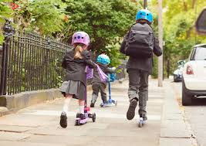
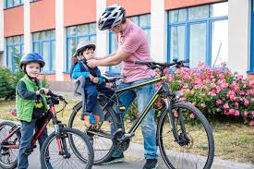
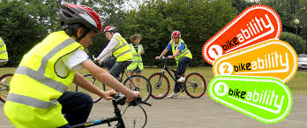
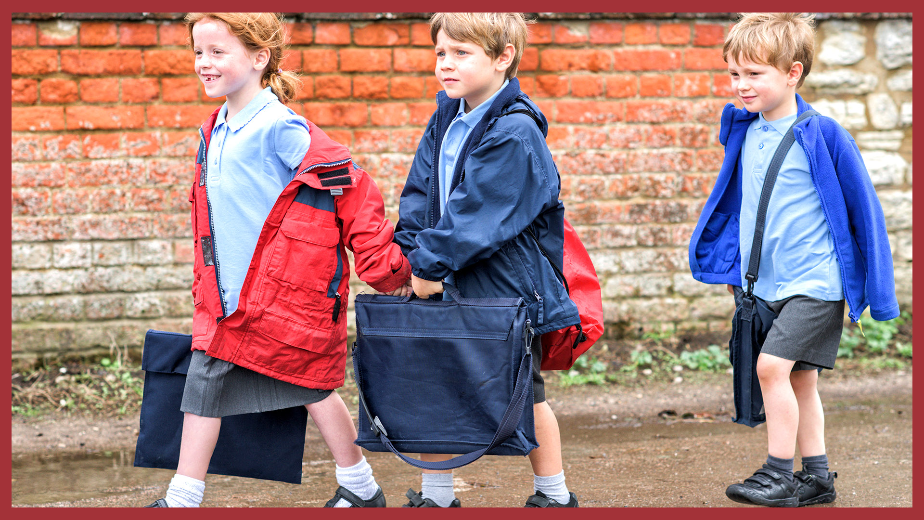
Did you know?
Walking to school every day of the week burns as many calories as a full two hours of PE.
Bikeability is cycling proficiency for the 21st century, designed to give the next generation the skills and confidence to ride their bikes on today’s roads. There are three levels from basic control skills practiced in the playground at Level 1 through to tackling a variety of road conditions under close supervision in Level 2 and 3. For more information about Bikeability and for contacts in our area, visit www.bikeability.org.uk
A 2012 study in Denmark found that children who walk or cycle to school demonstrate a measurable increase in concentration that lasts for up to four hours.
Walking, scooting and cycling (or even roller-skating) to school are great ways to build regular physical activity into young people’s lives. Research shows that those who travel to school actively take these positive behaviours into adulthood.

Slide 4
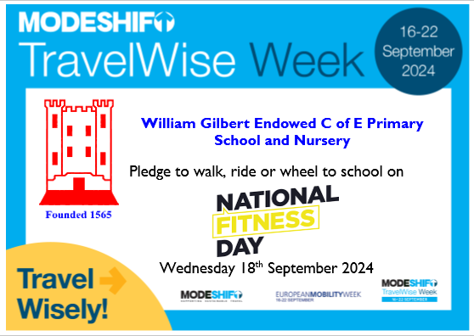

Slide 6
Join in
Join us and travel wisely with a
Walk,
Wheel or
Ride
to help create healthier, cleaner, greener and safer places for everyone!

Slide 7
Go for a walk or wheel
Go for a walk or wheel
Walking and wheeling are great ways to travel more actively.
It helps to keep you fit,
being outdoors helps boost your mental health
especially if you can walk and wheel with others and chat along the way,
and it’s environmentally friendly too!
Ways to celebrate walking and wheeling during Modeshift Travelwise week
If you can, swap a car journey for a walk and wheel to school, the shops or any other place.
Go on a walking and wheeling discovery trail to find out what your local area has to offer.
Organise an active travel breakfast to encourage walking and wheeling.

Slide 8
Get a ticket to ride!
Get a ticket to ride!
Buses and trains can transport a lot more passengers than cars
they save the hassle of finding somewhere to park
and you are less likely to get stuck in a traffic jam!
Ways to celebrate public transport during Modeshift TravelWise week
Checkout if there are any local public transport services near you and the places you travel.
Lookout for any special ticket deals and go for a bus or rail ride.
If the entire journey isn’t possible by public transport can you Park and Ride?

Slide 9
Share the ride
Share the ride
Reducing the number of cars on the road can help make the air cleaner,
reduce carbon emissions
and make it easier for walkers, wheelers and cyclists.
Ways to celebrate greener and cleaner roads during Modeshift TravelWise week
If travelling by car is the only option and you are travelling in the same direction as someone else can you give them a lift and car share?
Can you help create a fume free zone by switching off your engine or leave the car further away and Park and Stride, roll, glide or ride?

Slide 10
We look forward to you joining us
We look forward to you joining us!
#TravelWisely with a
Walk,
Wheel or
Ride
to help create healthier, cleaner, greener and safer places for everyone!

