Slide 1
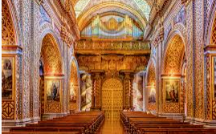
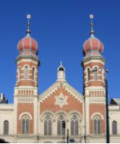
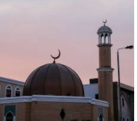
Year 1 How and why do we celebrate special and sacred places?
Prior Learning
I know a Church is where Christians go to worship.
Vocabulary
Pesach | The Jewish festival of Passover
Synagogue | A Jewish place of worship
Mosque | A Muslim place of worship
Ramadan | A Muslim festival where Muslims fast
Fasting | A time where Muslims don’t eat or drink during daylight hours.
We all have celebrations we like to share with our families and friends.
Christians celebrate the festivals of Harvest, Easter and Christmas.
Symbols of Easter include a palm leaf, a piece of bread and a glass of wine.
Jews celebrate the festival of Pesach (Passover).
The story of Pesach is about when the Jewish people left Egypt.
Mulsims fast during Ramadan.
Muslims celebrate Id-ul-Fitr.

