Slide 1
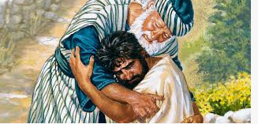
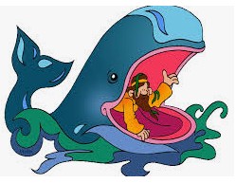
Year 11What do Christians believe God is like?
Prior Learning
Christians believe in God and they find out about Him in the Bible
Vocabulary
New Testament | The second half of the Bible
Old Testament | The first half of the Bible
Fair | Treating people the same
Forgive | To to stop feeling angry towards someone
Key Content
The story of the Lost Son is a parable and is found in the New Testament of the Bible.
This parable teaches Christians that God is loving and forgiving., like a parent.
Christians want to show God that they love Him , they do this by singing songs, praying, reading the Bible, loving and caring for others and going to church.
The story of Jonah is found in the Old Testament part of the Bible.
This story also tells Christians that God is fair and forgiving. Also, that God is everywhere and knows everything and He listens to our prayers.
If God loves everyone, hen Christians believe we should too.

