Slide 1
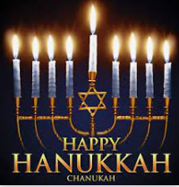
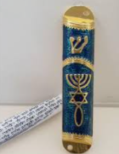
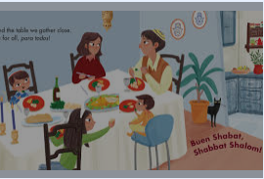
Year 1 Who is Jewish and what do they believe?
Prior Learning
Vocabulary
Synagogue | Jewish place of worship
Mezuzah | A container with a Hebrew prayer written on a scroll inside it and placed on a door post of a Jewish home
Shabbat | Jewish holy day
Chanukah | An eight day festival of lights when Jews remember the miracle of the oil burning
Jewish people follow the religion of Judaism.
The Jewish special book is called the Torah
Key Content
Jewish people have special objects in their homes linked to their religion.
A mezuzah contains a special prayer for Jewish people written in Hebrew and it is put on their outside door post.
Jewish people have a holy day each week (Friday) called Shabbat.
Chanukah is a festival of light and the story about it is found in the Torah . It is a happy time and reminds Jews about God’s miracles and standing up for what you think is right.

