Slide 1

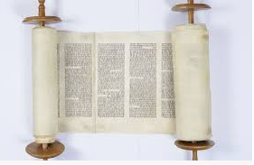



Year 2What can we learn from sacred books?
Prior Learning
Vocabulary
New Testament | The second half of the Bible which talks about Jesus’ life.
Parable | A story Jesus told which has another meaning.
Torah | The sacred book for the Jewish people
Muhammad | The founder of Islam- the religion for Muslims.
Christians’ special book is called the Bible.
Muslims’ special book is called the Qur’an
Religious stories give us messages about how we should live our lives.
Key Content
Most of us have a story or a book that is special to us.
Books that are special to believers are called sacred or holy.
Jesus told many stories in the New Testament. These are called parables. They have hidden meanings. The parable of the Lost Sheep is about how much God loves and cares for everyone of us.
When Jesus told the Sermon on the Mount he was showing us how we should treat each other.
The Jewish sacred book is called the Torah. The story of Moses can be found in here. It is also found in the Bible.
The story of Jonah is also in the Torah and the Bible. This story tells us about forgiveness.
The Muslim’s sacred book, the Qur’an also contains stories. One of these is Muhammad and the Black stone. This story tells us how to be trustworthy.

