Slide 1
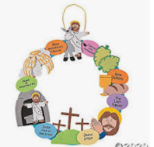
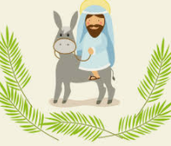
Year 2 Why does Easter matter to Christians?
Prior Learning
Vocabulary
Jerusalem | a city in Israel it is thought to be one of holiest places in the world
betrayal | Giving information to an enemy. Jesus was betrayed to the Romans by Judas
resurrection | Risen from the dead- come back to life.
Easter is very important in the big story of the Bible.
Christians believe that Jesus rose again, giving people hope of a new life.
Key Content
The life of Jesus and the many things he said and did are found in the Gospels in the Bible
The Easter story is one of sadness, followed by great joy.
The story of Easter has five main parts; the entry into Jerusalem, Jesus’ betrayal, the crucifixion, the empty tomb and Jesus appearance to the disciples.
Jesus was a bridge between us and God- when He died on the cross he paid the price of sin in the world and reunited us with God.
Christians believe that when they die they can also have a new life with God in heaven.
Christians believe that Jesus taught us and showed us how to live our lives. We should forgive others just like God forgives us when we do something wrong.

