Slide 1


Slide 2
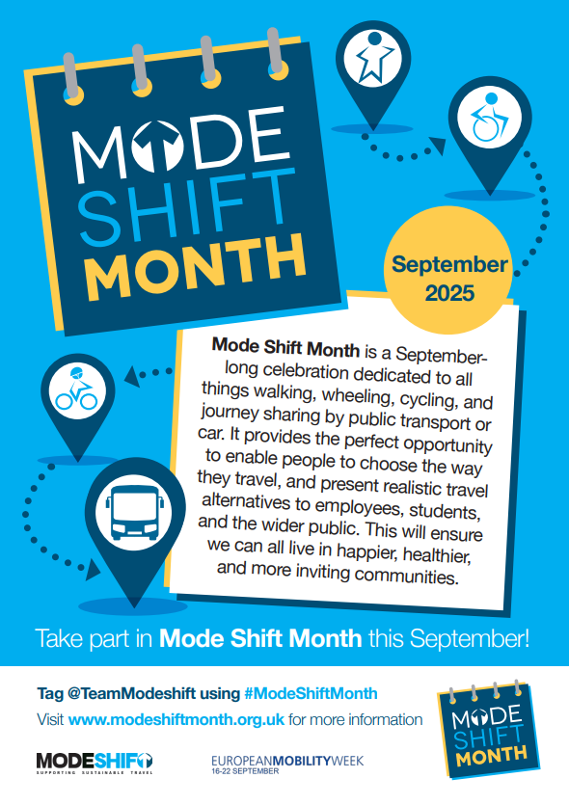

Mode Shift Month is a September-long celebration dedicated to all things walking, wheeling, cycling, and journey sharing by public transport or car.

Slide 3

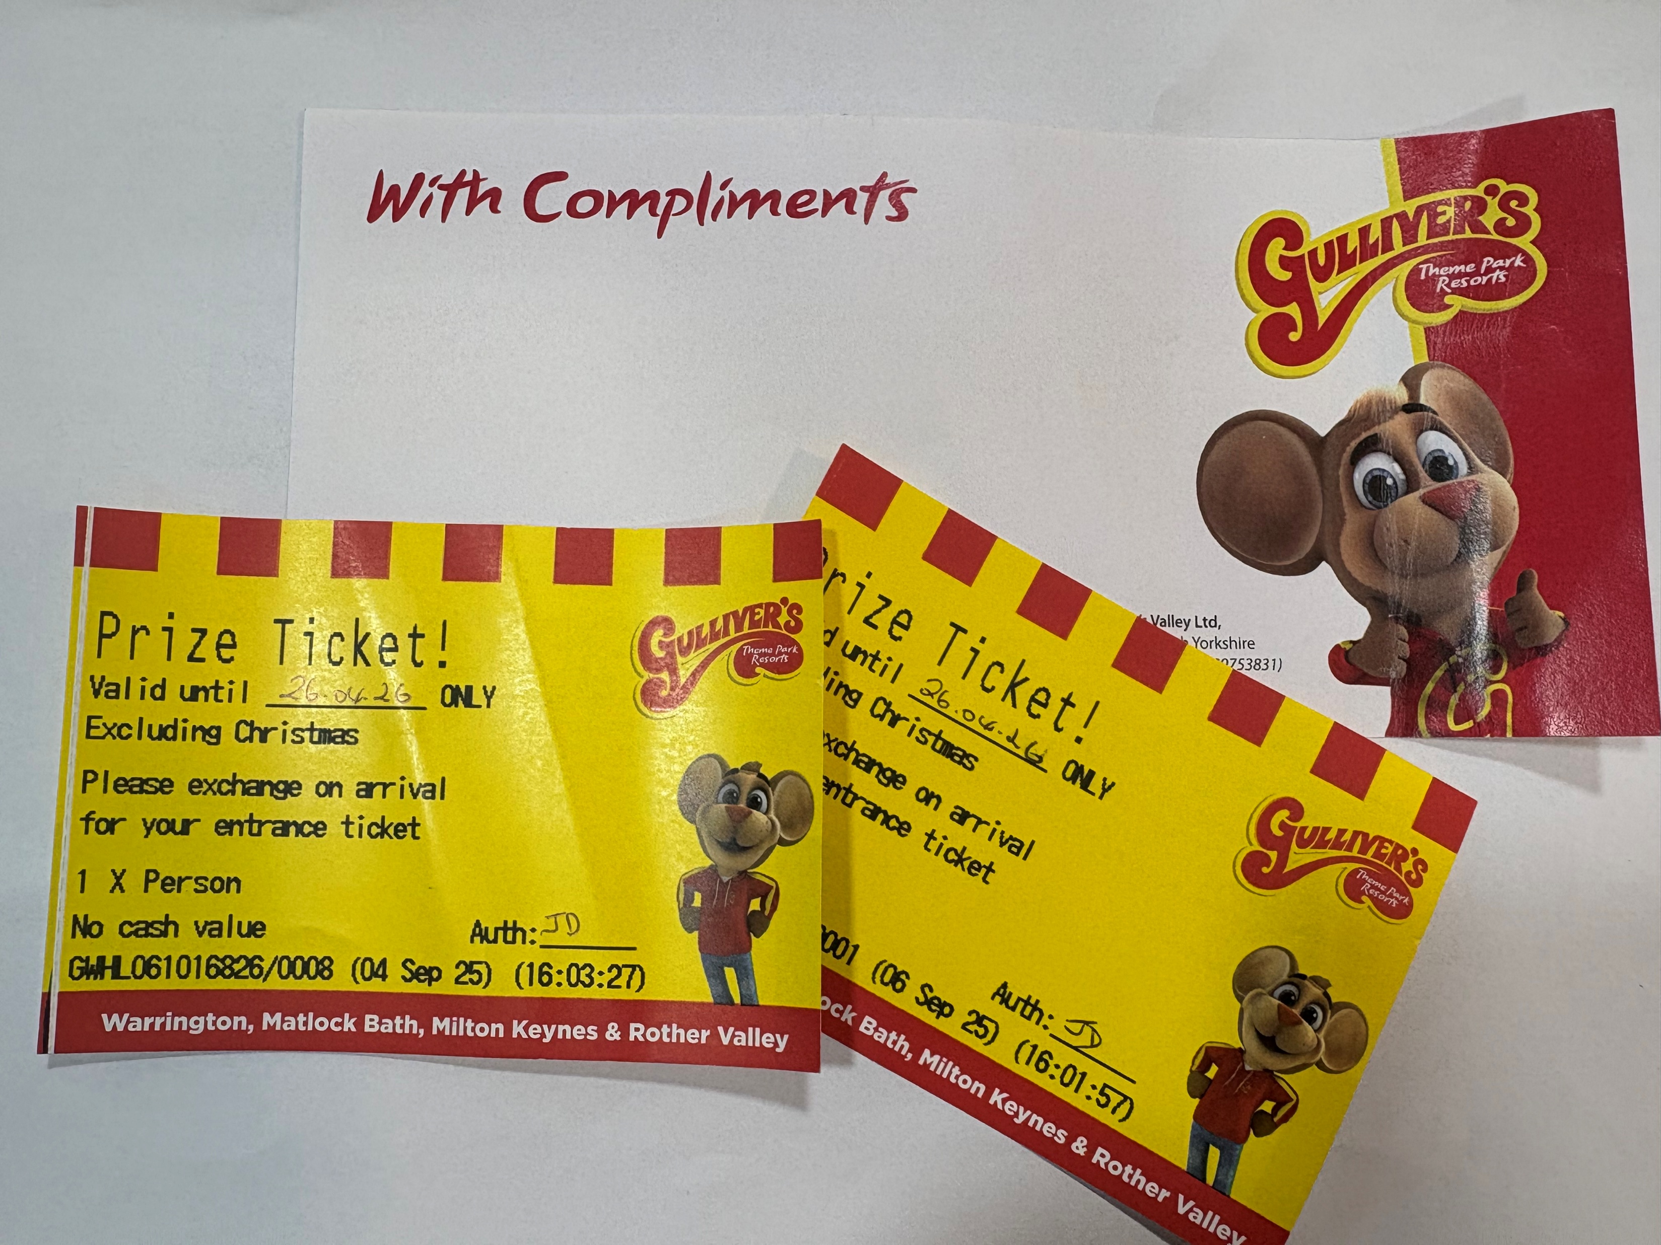
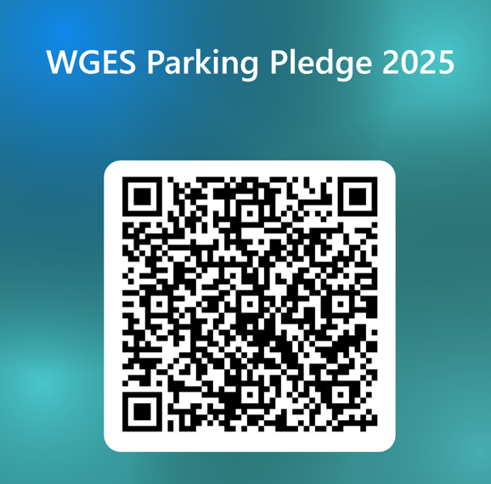
We are excited to announce the Parking Pledge prize – 2 tickets to Gulliver’s Kingdom !
Ask your parent to Scan the QR code to agree to support our pledge and your name will be entered into the prize draw at the end of September.
William Gilbert School is proud to be the first in Derbyshire to operate a School Street. As part of our commitment to safer, healthier travel, we pledge to reduce traffic, improve road safety for our pupils, and support cleaner air by encouraging families to walk, cycle, or scoot whenever possible — and to park respectfully when driving is necessary.

Slide 4

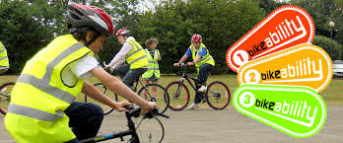

William Gilbert Endowed C of E Primary School and Nursery pledge to
Get Safe to Cycle
with pupil bike ability sessions for Y6 pupils – 15th -17th September

Slide 5
William Gilbert Endowed C of E Primary School and Nursery pledge to
t
0
b
e
S
o
w
u
p
H
e
r
S
S
T
C
T
C
R
O
R
O
O
A
O
T
A
T
M
E
M
E
S
R
S
R
Get Scooter Smart
with pupil and parent scooter workshops – Thursday 18th September

Slide 6

William Gilbert Endowed C of E Primary School and Nursery pledge to
t
0
b
e
S
o
w
u
p
H
e
r
S
S
T
C
T
C
R
O
R
O
O
A
O
T
A
T
M
E
M
E
S
R
S
R
Create a Safe Scooter Code with the help of our Junior Travel Ambassadors

Slide 7

William Gilbert Endowed C of E Primary School and Nursery pledge to
Walk, ride or wheel to school on Monday 22nd September for World Car Free Day

Slide 8
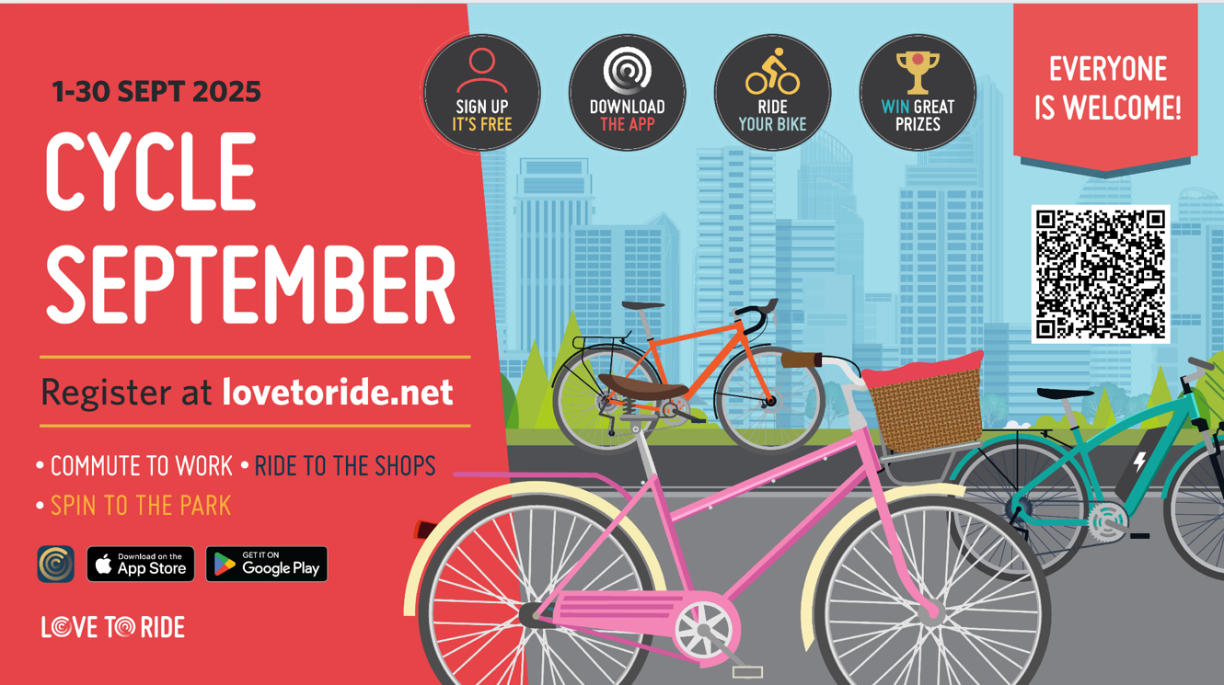
William Gilbert Endowed C of E Primary School and Nursery pledge to
Cycle more in September and take part in the Love to Ride challenge

Slide 9
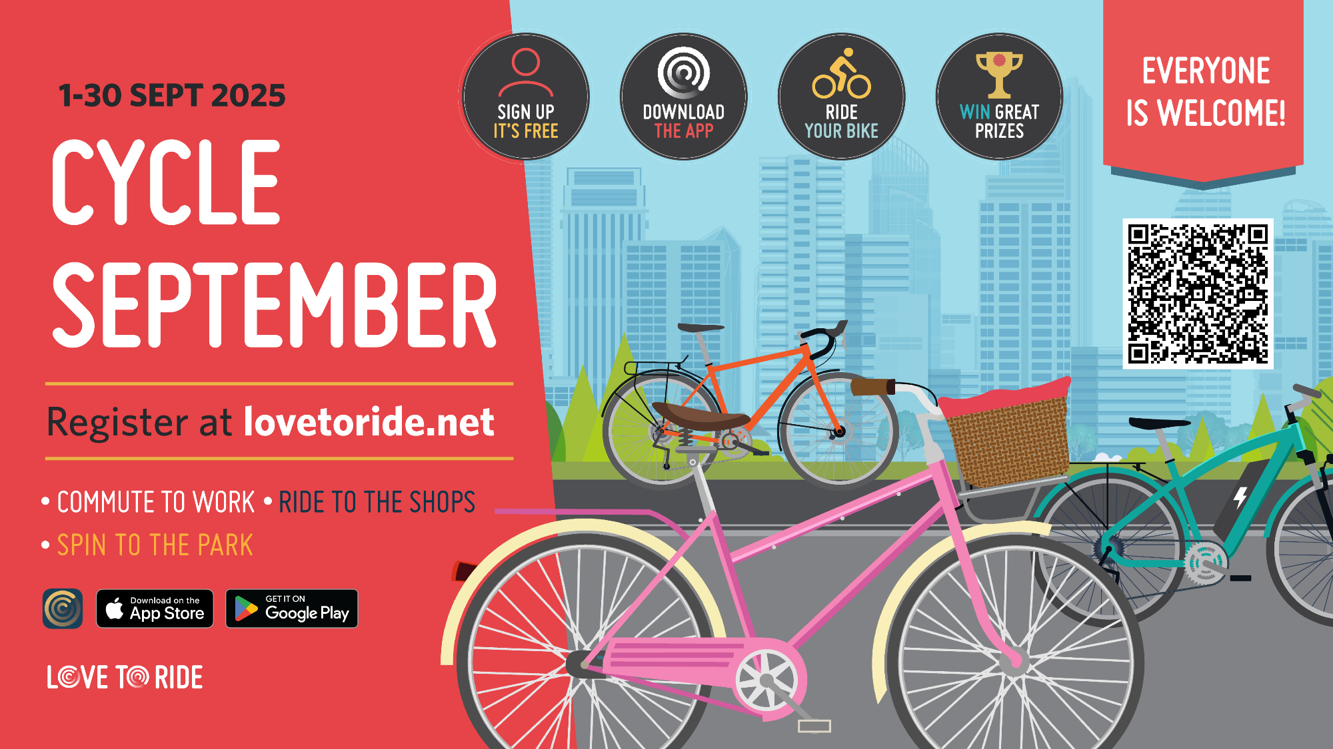

Slide 10
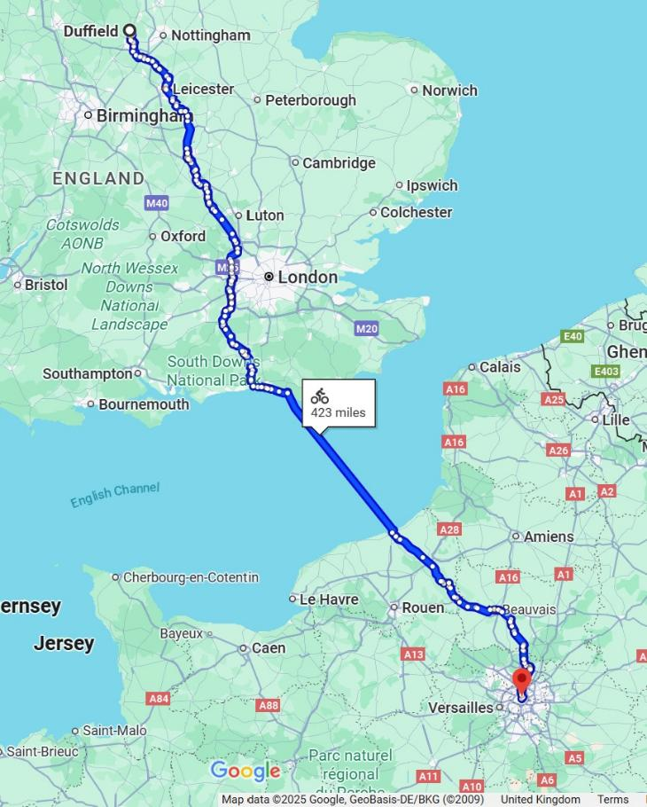
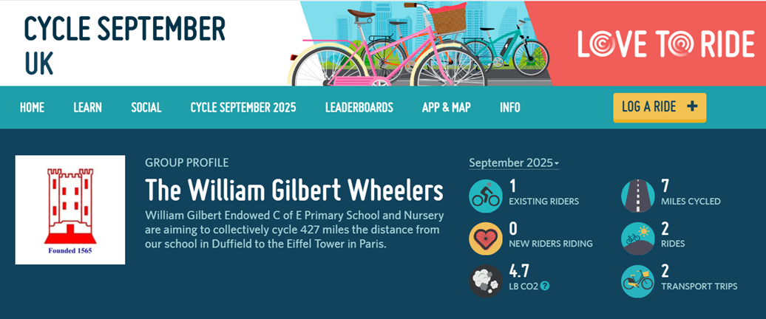



Join the William Gilbert Wheelers Duffield to Paris Cycle Challenge
Sign up and create a family profile on Love to Ride.
Join the William Gilbert Wheelers group.
Go for a cycle ride and record your miles – either automatically in the app or manually on the website.
You can even share a photo there too if you want.
Remember every mile counts – it can be a cycle to work or school, a quick pedal to the shops or a ride to the park!

Slide 11

Also during Mode Shift Month…
The Lucky Lock is back! Once a week, every week in September!
Will you find your scooter or bike has the ‘lucky lock’ at the end of the day? Scoot or ride to school and park it safely in the scooter pod or cycle rack to be in with a chance of winning a spot prize!

Slide 12
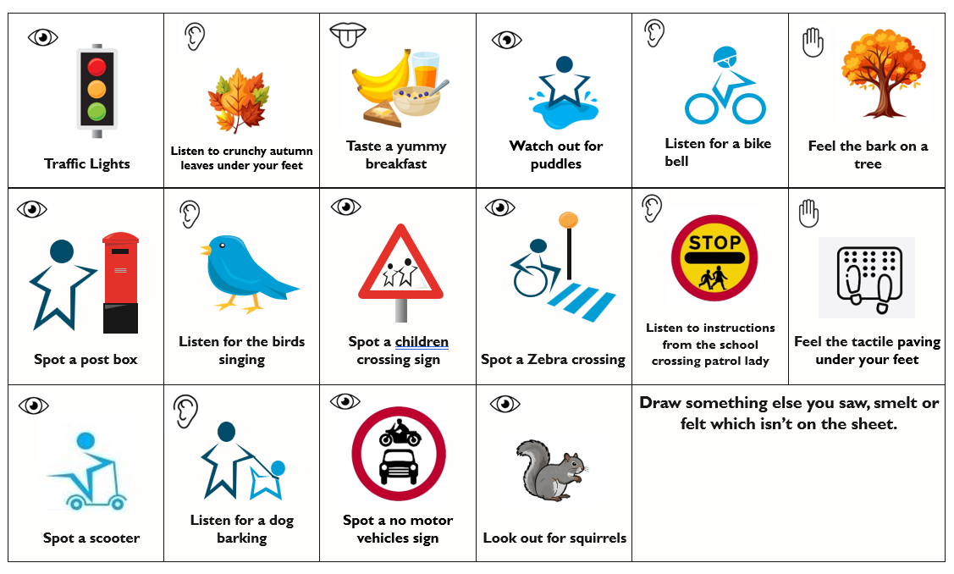
Mode Shift Month Autumn Travel Trail
Instructions: Cross off the items below when you see, taste, hear or feel them on your journey to or from school.

Slide 13
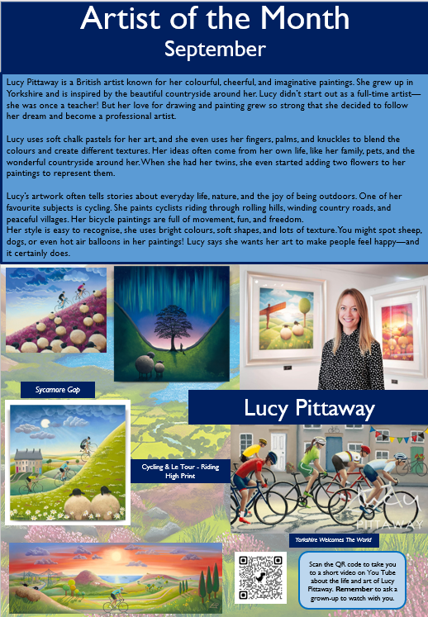
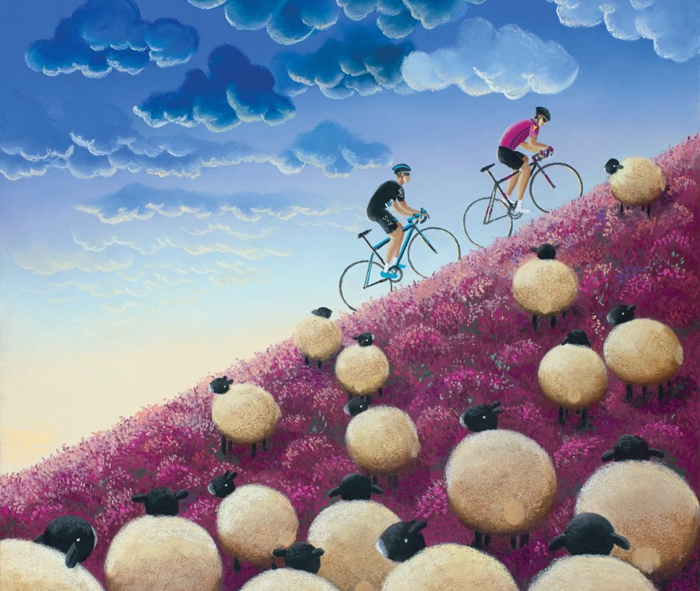
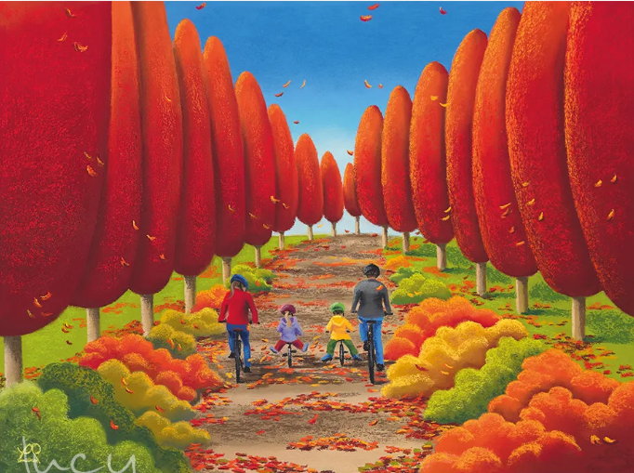
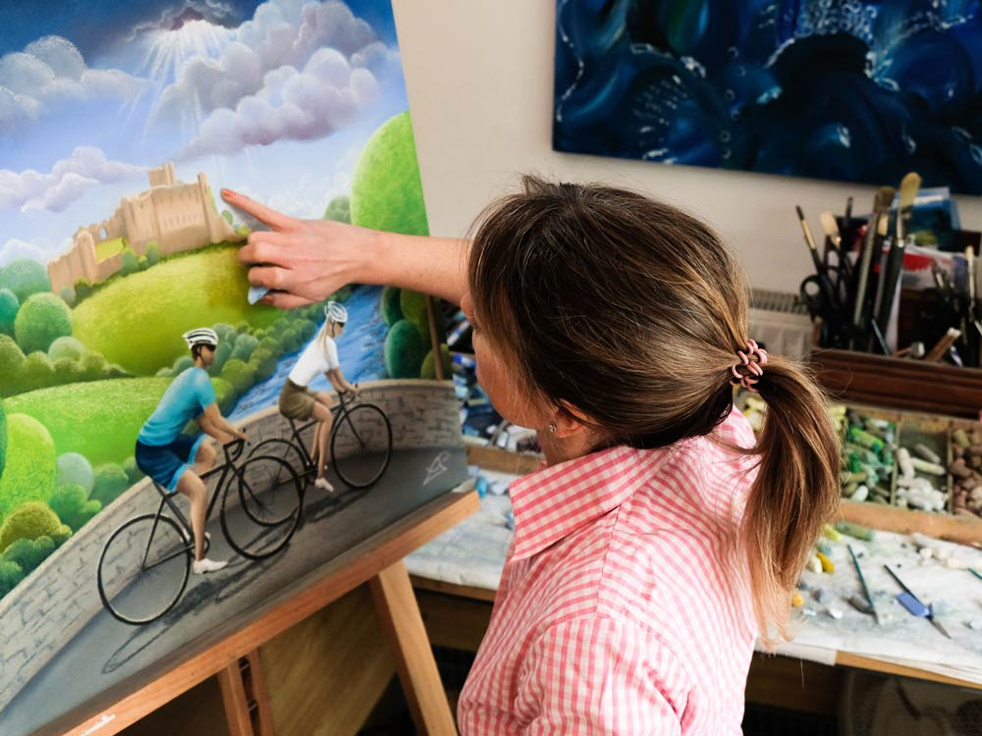
Active Artist of the Month

Slide 14
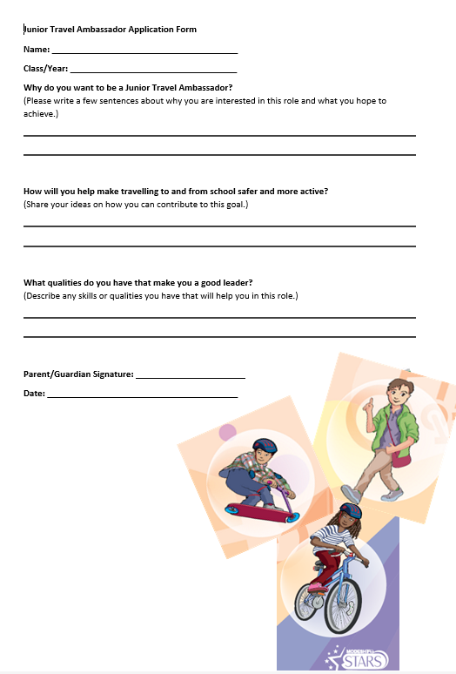
The Junior Travel Ambassadors
We are looking for new recruits. Have you got what it takes to help create a healthier, cleaner, greener and safer school? Let us know on the quick application form.

Slide 15
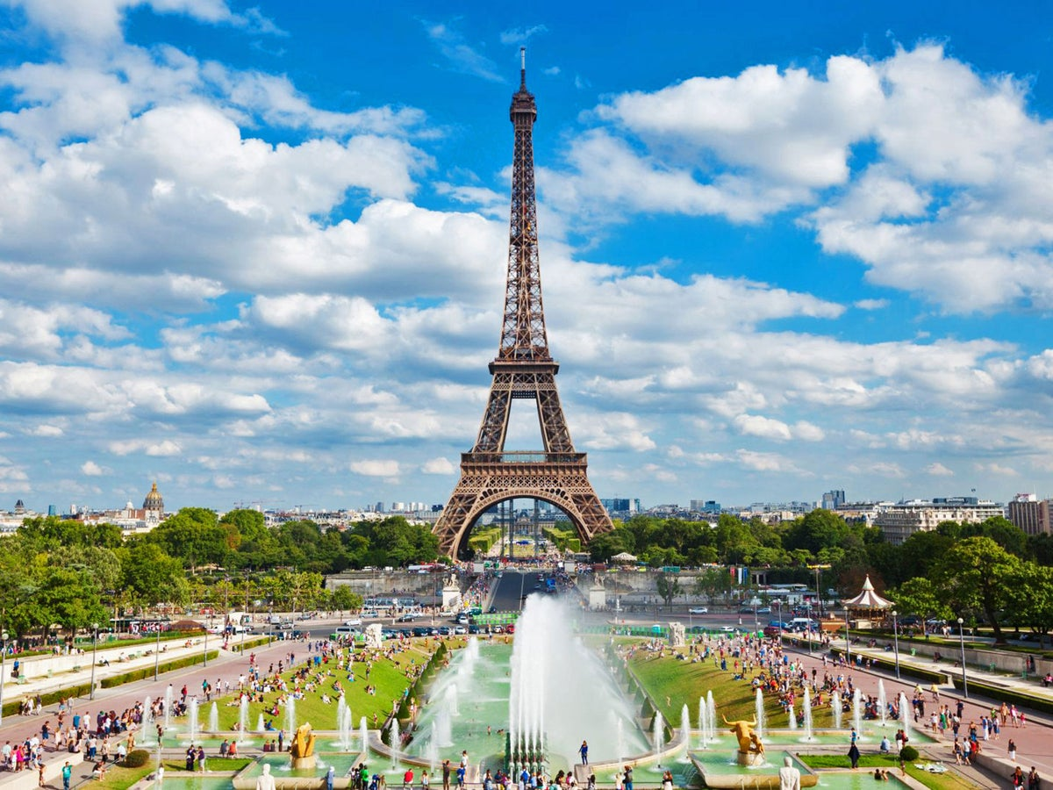
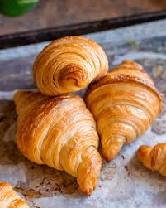
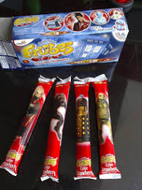
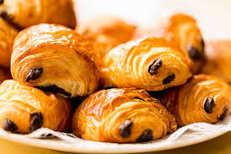
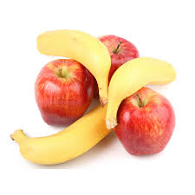
Mode Shift Month Celebration – 30th September
Get involved
We will be keeping our air cleaner throughout September. On the last day of Mode Shift Month can you leave the car at home and walk, scoot or cycle to school? Let's celebrate all we have achieved in Mode Shift Month together.
Come and grab an active breakfast snack served at the infant and junior gates served by our PTA and staff.
There will be croissants, pain au chocolat, yogurts and fruit to choose from.
Can we collectively cycle 427 miles to reach the Eiffel Tower in Paris, France?
Active Breakfast for all!

Slide 16

#TravelWisely with a
Walk,
Wheel or
Ride
to help create healthier, cleaner, greener and safer places for everyone!

